Slide 1
Vehicle Management System - VMS
Presenters:
Ganesh, Jagravi, Krishna,
Maharshi, Sebastian, Shivaprasad

Slide 2
Topics
Introduction
Project overview
Requirements
System modelling
Use case diagram
Sequence diagram
State chart diagram

Slide 3
Introduction

Slide 4
About our company
XYZ consultants located in downtown, Cleveland, OH
5 year old company with substantial experience in software engineering and creating business applications
6 skilled employees which include project manager, business analysts and software designers

Slide 5
Project Overview
Designed for vehicle management department that manages the vehicles within the consolidated industries
Implement a vehicle management system with the purpose of
Replacing the ineffective fleet management system
Effective management of the vehicle’s within the consolidated industries fleet
Decrease the vehicle management department's workload

Slide 6
Objectives of VMS
Provide online reservation feature to customer
Track vehicles at all times
Marketing the vehicles to the corporation employees
Maintenance Alerts

Slide 7
Requirements
Functional
Non-functional
Data

Slide 8
Functional Requirements
VMS must place and track vehicle request orders
VMS should generate the information necessary for determining the best selling time of the vehicle
VMS must track where a vehicle is at all times
VMS must handle and generate receipts at the time of check-in and check-out
VMS must update vehicle maintenance history
VMS must have an alert system to remind the assignees about the vehicle’s scheduled maintenance
VMS must aid in providing replacement vehicles for vehicles that are in for scheduled maintenance

Slide 9
Non-Functional Requirements
The system should always be available for access except for few days which would be used for maintenance of the system
VMS must make the workflow of the vehicle management department to be simple
VMS must be user friendly and must maintain accurate data

Slide 10
Data Requirements
VMS must maintain the resale value data for each make and model and should also maintain the age, mileage, expected maintenance cost data for each vehicle.
VMS should maintain the renting department budgets data of each department within the corporation.
VMS must provide information about the vehicle’s warranty period.

Slide 11
System Modelling
Use case diagram
State chart diagram
Sequence diagram
Deployment diagram

Slide 12
Use Case Diagram

Slide 18
State Chart & Associated Sequence Diagrams

Slide 19

Statechart for Vehicle Request

Slide 20
Create Vehicle Request

Slide 22
Cancel Vehicle Request

Slide 24
Assign Vehicle

Slide 25
Statechart for Vehicle Status

Slide 26
Assign Vehicle

Slide 28
Vehicle Check-Out

Slide 30
Maintenance Check In

Slide 32
Maintenance Check Out

Slide 34
Check In Vehicles

Slide 35
Deployment Diagram

Slide 36
Deployment diagram

Slide 37


Slide 39
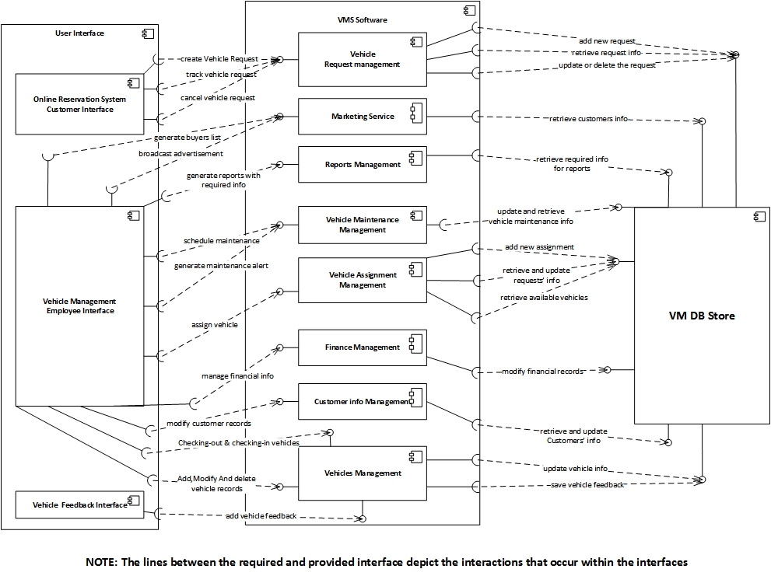

Slide 40
